Slide 1
Git for newbie
Web dept
Tran Dinh Hung

Slide 2
Agenda
Introduction
What is git?
Why should we use git?
Setup and foundation concepts
Repository
Branch
Tag
Git-flow

Slide 3
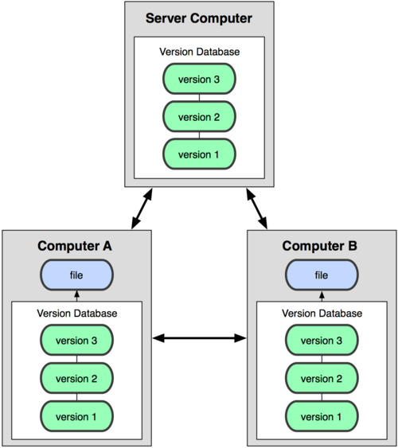

1.1 What is git?

Slide 4
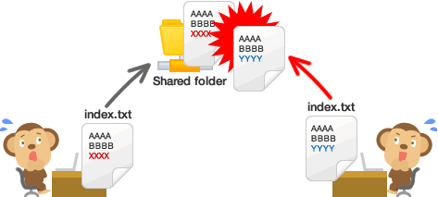
1.2 Why should we use git?
Easy to use, safe and quick
Easy to manage code, code revision history
Work offline
Work with team easier
Easy to deploy product

Slide 5
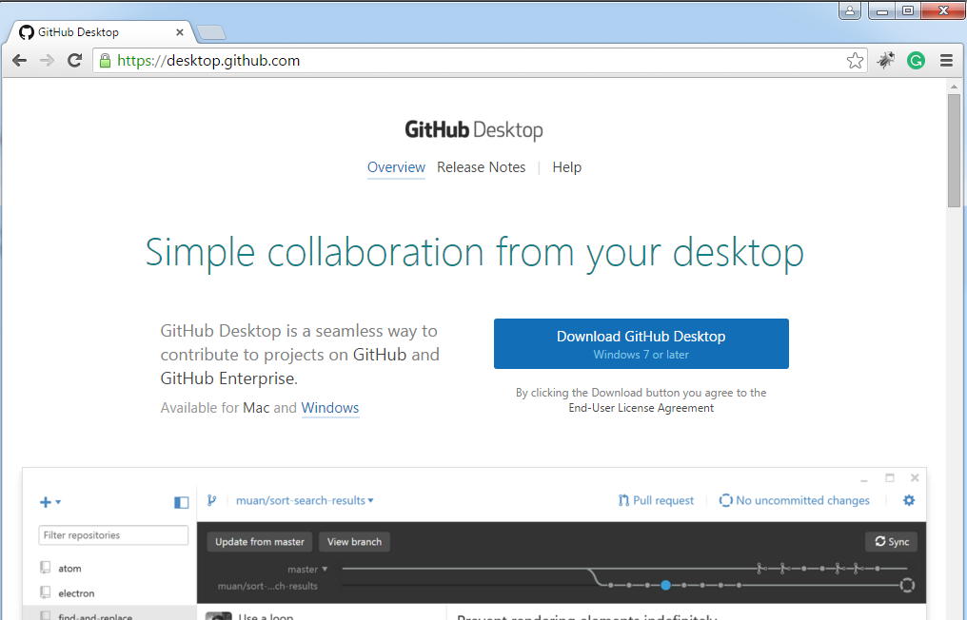
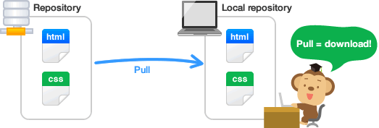
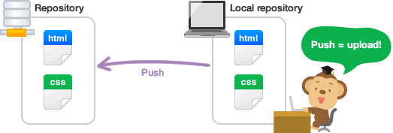
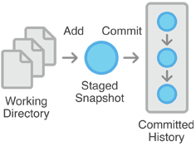
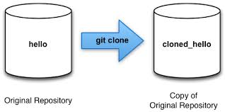
2. Setup and foundation concepts
2.1 Setup
2.2 Commit
2.3 Push
2.4 Pull
2.5 Clone
2.6 Merge

Slide 6
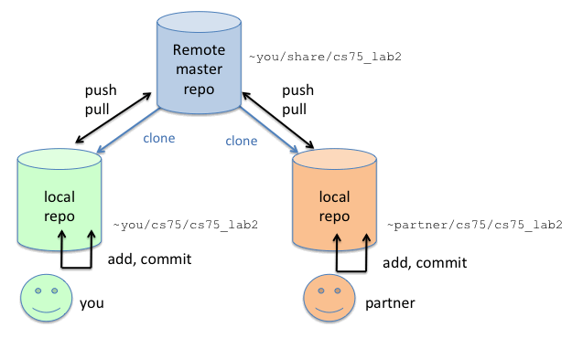
3. Repository
Setup on server
Share resource between multi user
Storage for revision history and state of folder and file
Setup on local
Only one local user

Slide 7
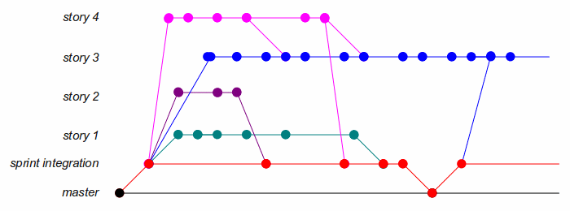
4. Branch
Used to ramify, record the flow of history
Not affect the other branches
Can be merged together

Slide 8
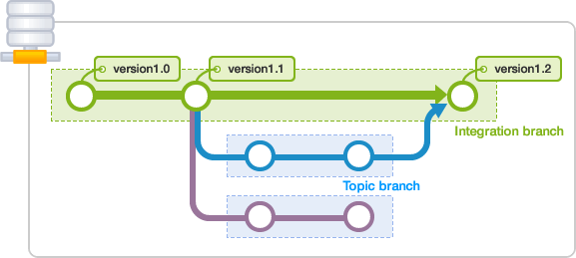
4. Branch
Already to release product
Resource to ramify for topic branch
Stable is necessary
The place to merge other branches
Intergration Branch
Branch
Created based on specified job
Created from stable integration branch
Merge into integration branch
Topic Branch

Slide 9
5. Tag
- A symbolic names for a given revision
- They do not change

Slide 10
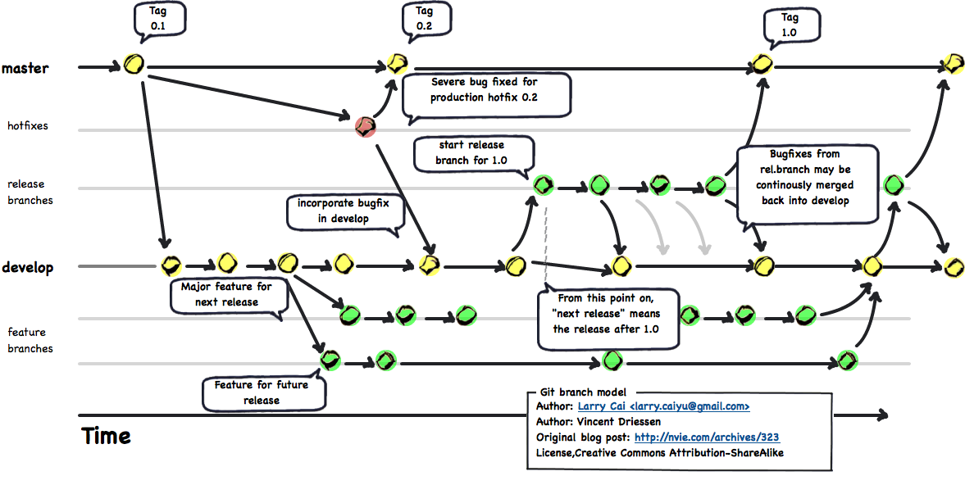
6. Git Flow
1. A set of git extensions
2. Providing high-level operations for Vincent Driessen’s branching model
3. A merge based solution

Slide 11
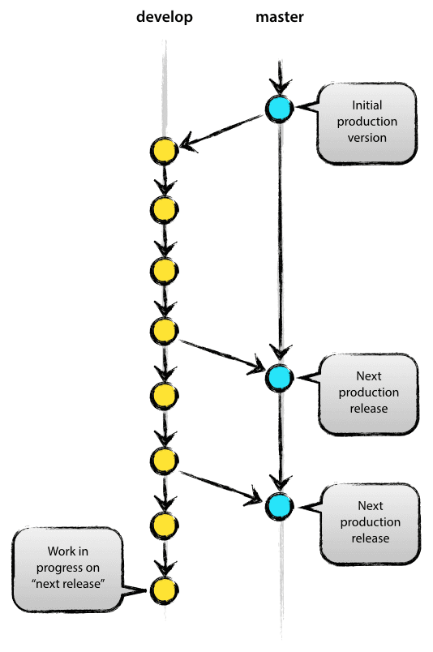
6. Git Flow
DEVELOP
Serving as an integration branch for features
MASTER
Storing the official release history

Slide 12
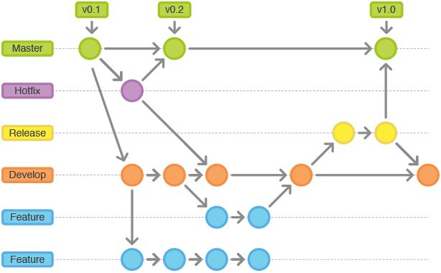
6. Git Flow
Supporting branches
Feature branches
Release branches
Hotfix branches

Slide 13
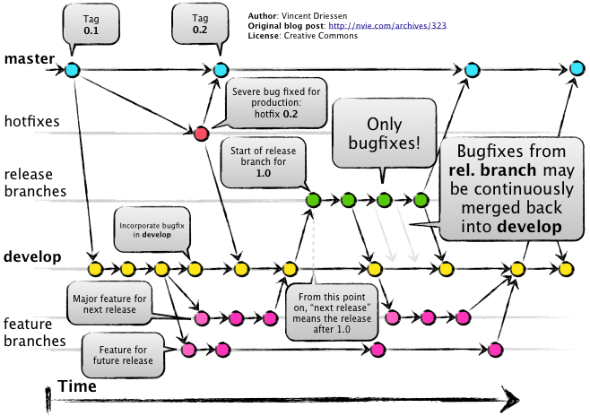
6. Git Flow

Slide 14

Q&A

Slide 15


